Slide 1
studyhub.com

Slide 2
Team Details:
Shivam Rajput (Admin) - B.Tech(CSE)
Siddhant Jain - B.Tech(CSE)
Akshit Kumar - B.Tech(CSE)
Aryan Shukla -B.Tech(CSE)

Slide 3


Technology Stack:

Slide 4
Work-flow:
Registration
Login
Borrow/Return Book
Project making
Step 1:
Step 2:
Step 3:
Stationery purchase
Urgent printout
Step 4:
Name of book and author
Project Details Entry
Product details
PDF of document to be printed
Step 5:
Entry of time In which project is required and payment procedure
Choose product and order placing
Get print within 20 minutes

Slide 5

Idea Details
Many books that are very much expensive to afford can easily be borrowed through our website.
Many of the students are assigned projects that can be completed with the help of our website.
Our web portal also provides room to purchase stationery items at cheaper details.

Slide 6
1. There are many students who are unable to buy expensive books. Those who have them and have read such books can provide them on rent to the latter. 2. Stationery items can be provided at the least price to the students, 3. Many a times we need printouts and the shops for print out are not open. In such cases the individuals can access from our website, the nearest cyber café already registered on our portal .
Purpose:

Slide 7
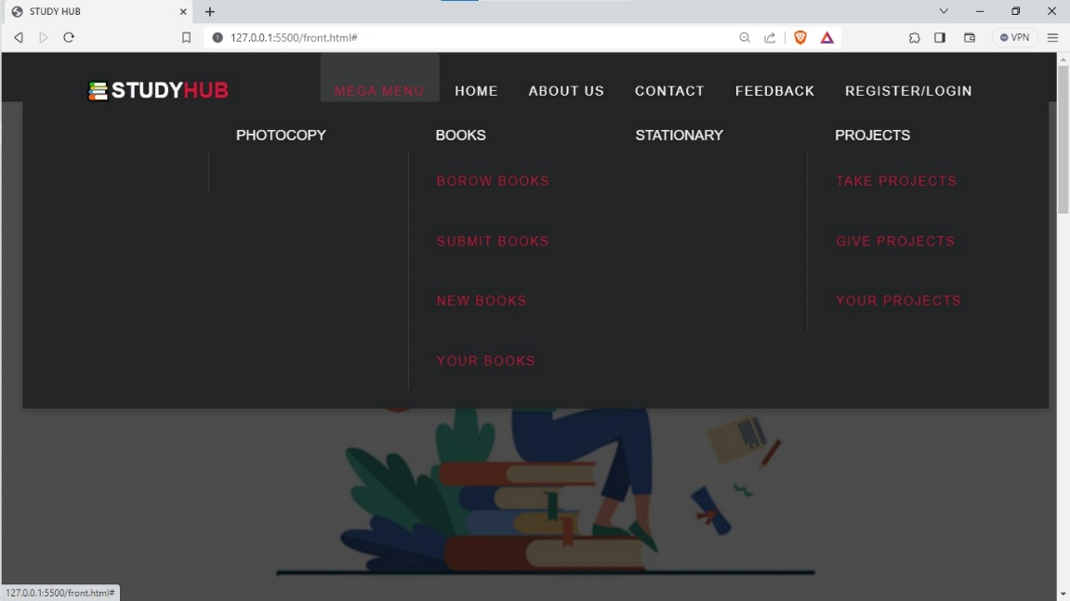
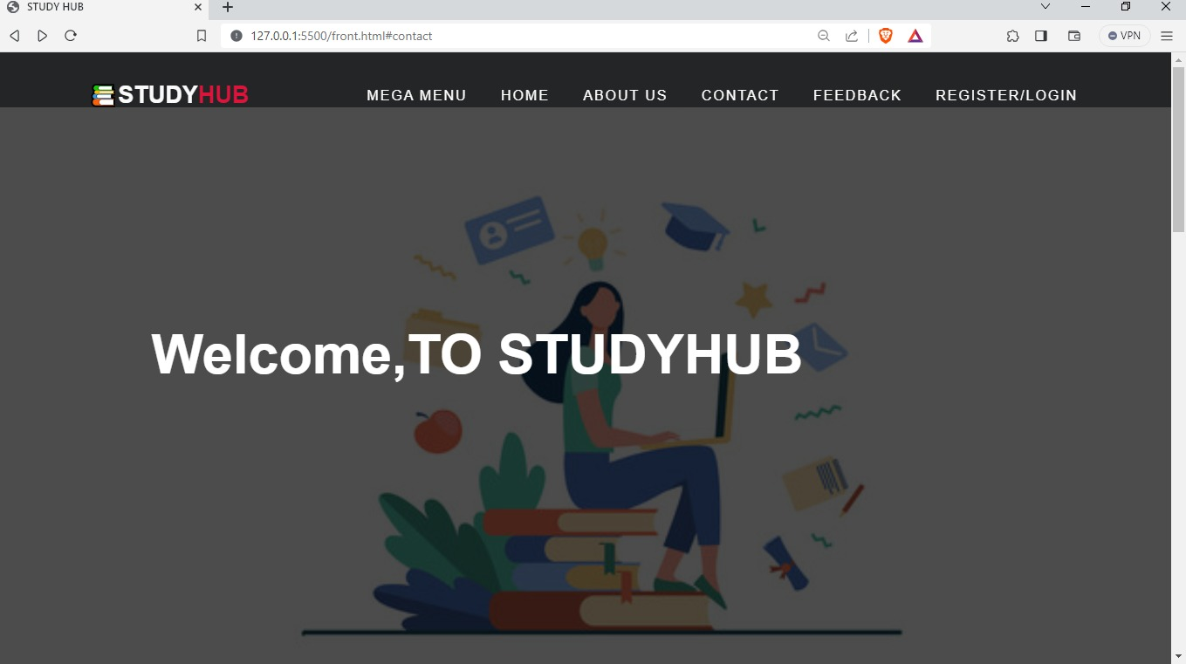
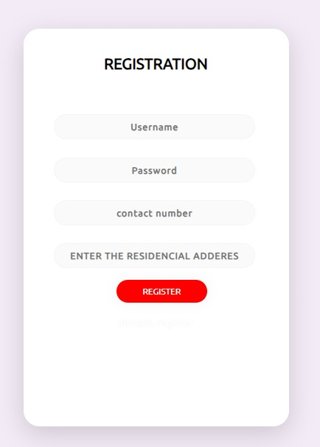
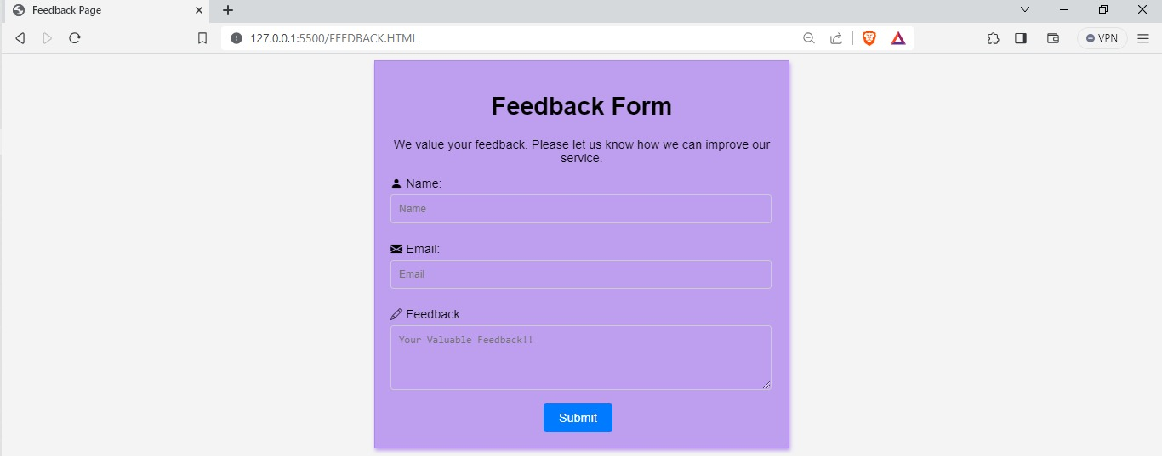
Prototype

Slide 8
Thank You

